Slide 1

VM Emulator Tutorial
This program is part of the software suite
that accompanies the book
The Elements of Computing Systems
by Noam Nisan and Shimon Schocken
MIT Press
www.nand2tetris.org
This software was developed by students at the
Efi Arazi School of Computer Science at IDC
Chief Software Architects: Yaron Ukrainitz and Yannai Gonczarowski

Slide 2

Background
The Elements of Computing Systems evolves around the construction of a complete computer system, done in the framework of a 1- or 2-semester course.
In the first part of the book/course, we build the hardware platform of a simple yet powerful computer, called Hack. In the second part, we build the computer’s software hierarchy, consisting of an assembler, a virtual machine, a simple Java-like language called Jack, a compiler for it, and a mini operating system, written in Jack.
The book/course is completely self-contained, requiring only programming as a pre-requisite.
The book’s web site includes some 200 test programs, test scripts, and all the software
tools necessary for doing all the projects.

Slide 3

The Book’s Software Suite
(All the supplied tools are dual-platform: Xxx.bat starts
Xxx in Windows, and Xxx.sh starts it in Unix)
Simulators
(HardwareSimulator, CPUEmulator, VMEmulator):
Used to build hardware platforms and
execute programs;
Supplied by us.
Translators (Assembler, JackCompiler):
Used to translate from high-level to low-level;
Developed by the students, using the book’s specs; Executable solutions supplied by us.
This tutorial is about the
VM emulator
Other
Bin: simulators and translators software;
builtIn: executable versions of all the logic gates and chips mentioned in the book;
OS: executable version of the Jack OS;
TextComparer: a text comparison utility.

Slide 4
VM Emulator Tutorial
Getting Started
Using Scripts
Debugging
Relevant reading (from The Elements of Computing Systems):
Chapter 7: Virtual Machine I: Stack Arithmetic
Chapter 8: Virtual Machine II: Program Control
Appendix B: Test Scripting Language, Section 4.

Slide 5

VM Emulator Tutorial
Part I:
Getting Started

Slide 6
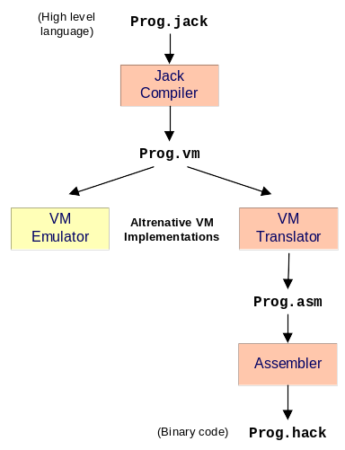
The Typical Origin of VM Programs
VM programs are normally written by compilers
For example, the Jack compiler (chapters 10-11) generates VM programs
The VM program can be translated further into machine language, and then executed on a host computer
Alternatively, the same VM program can be emulated as-is on a VM emulator.
Supplied by us
Built in projects 7 and 8

Slide 7
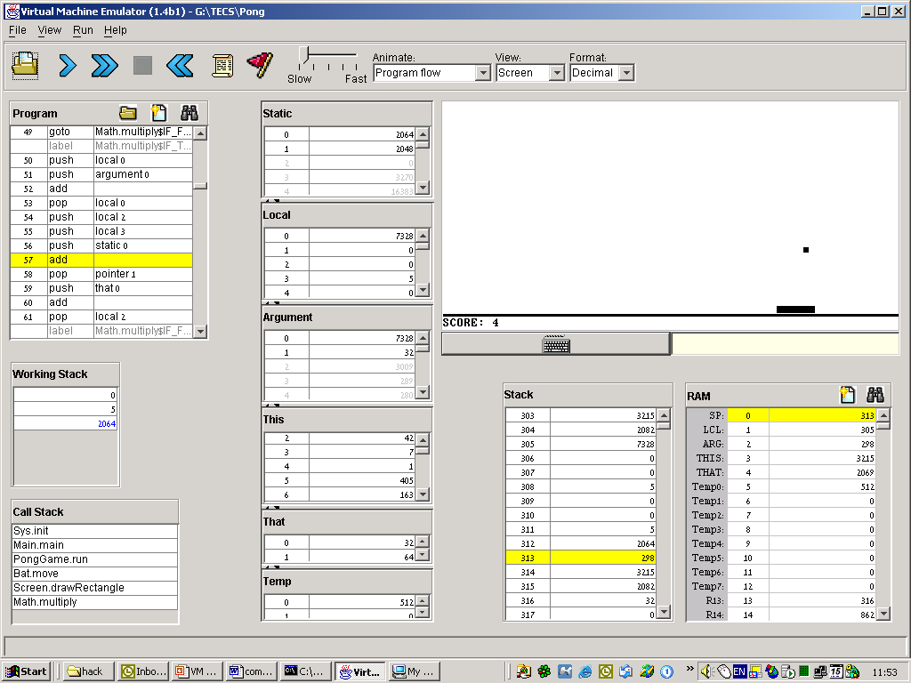
Example: Pong game (user view)
Ball moves and bounces off the walls “randomly”
Number of successful hits
User move the bat left and right, trying to hit the ball
Now let’s go behind the scene ...

Slide 8
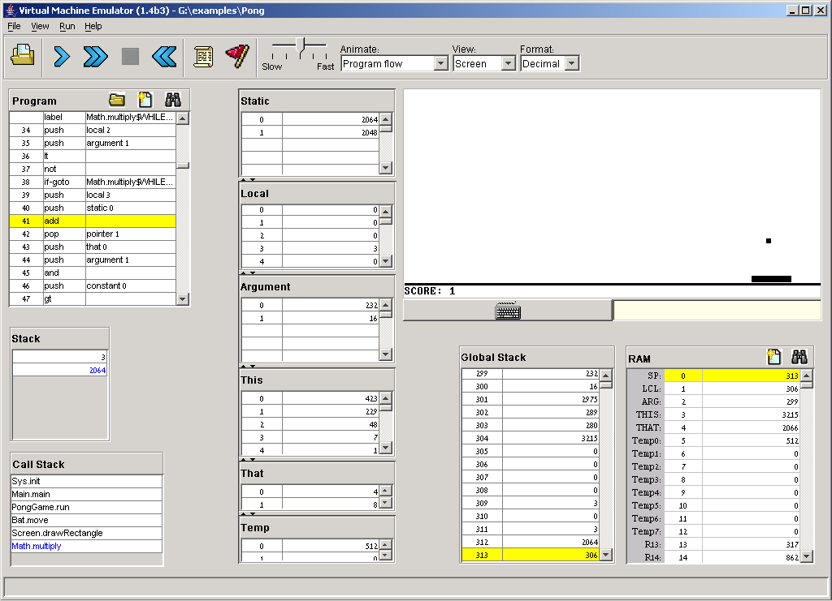
VM Emulator at a Glance
VM program
(In this example:
Pong code
+ OS code)
Screen:
(In this example: Pong game action)
Virtual memory segments
The VM emulator serves three purposes:
Running programs
Debugging programs
Visualizing the VM’s anatomy
The emulator’s GUI is rather crowded, but each
GUI element has an important debugging role.
Keyboard enabler
Working stack:
Topmost part of the global stack, as seen by the VM program
Not Part of the VM!
(displayed in the VM emulator
for reference purposes)
Call stack:
Hierarchy of all the functions that are currently running
Global stack:
Function frames + working stack
Host RAM:
Stores the global stack, heap, etc.

Slide 9
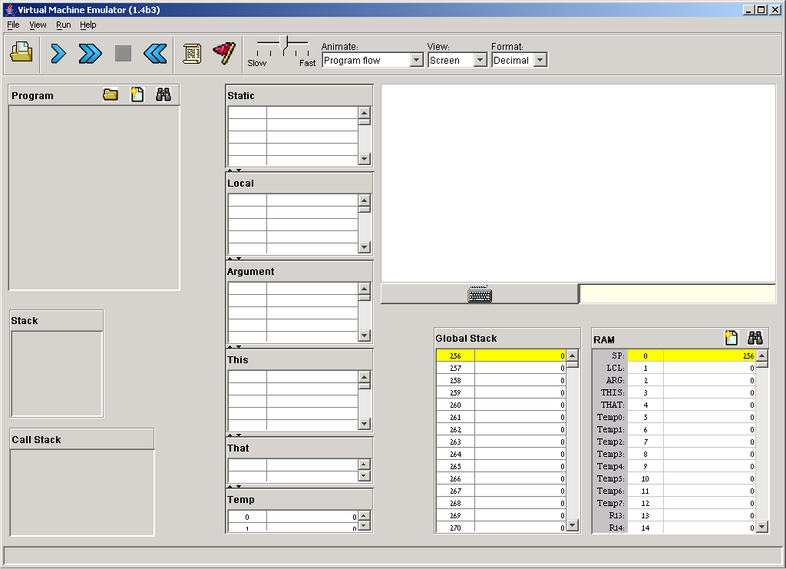
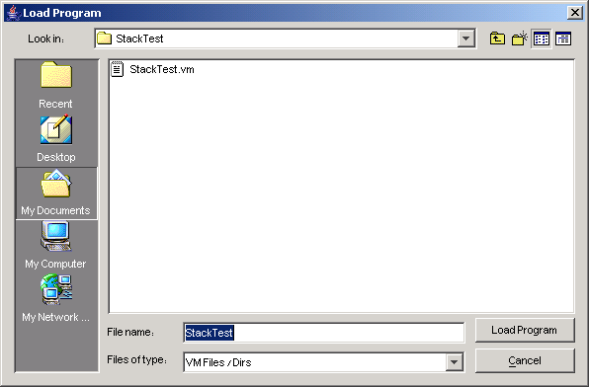
Loading a VM Program
Let’s start with a trivial VM program that manipulates only the stack (i.e. does not involve the memory segments Static, Local, Argument, etc.);
VM programs that don’t manipulate memory segments can be loaded via the “load file” button.
Navigate to a directory and select a .vm file

Slide 10
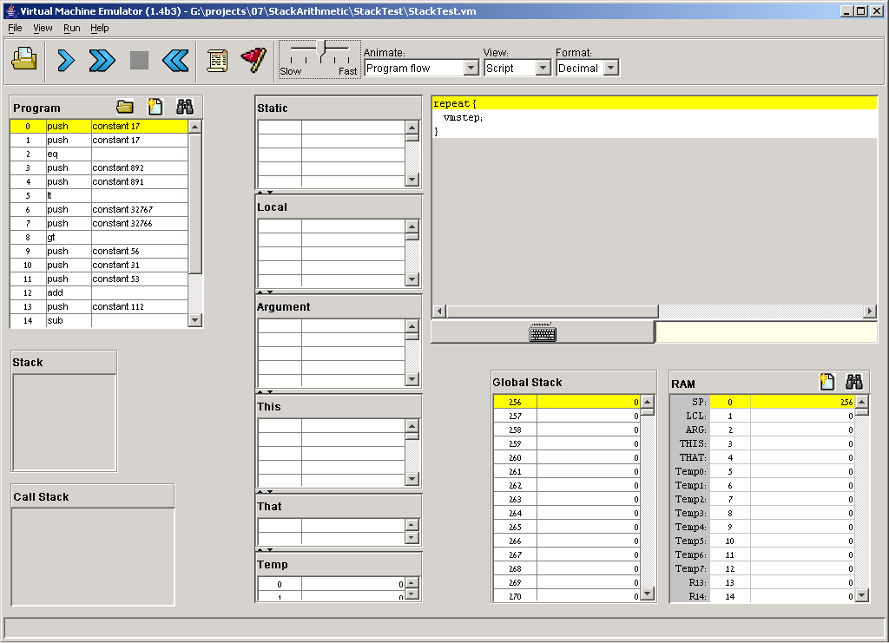
Running a Program
Script controls
Default test script
Always loaded, unless another script is loaded by the user.
VM code is loaded: (read-only)
The index on the left is the location of the VM command within the VM code (a GUI effect, not part of the code).

Slide 11
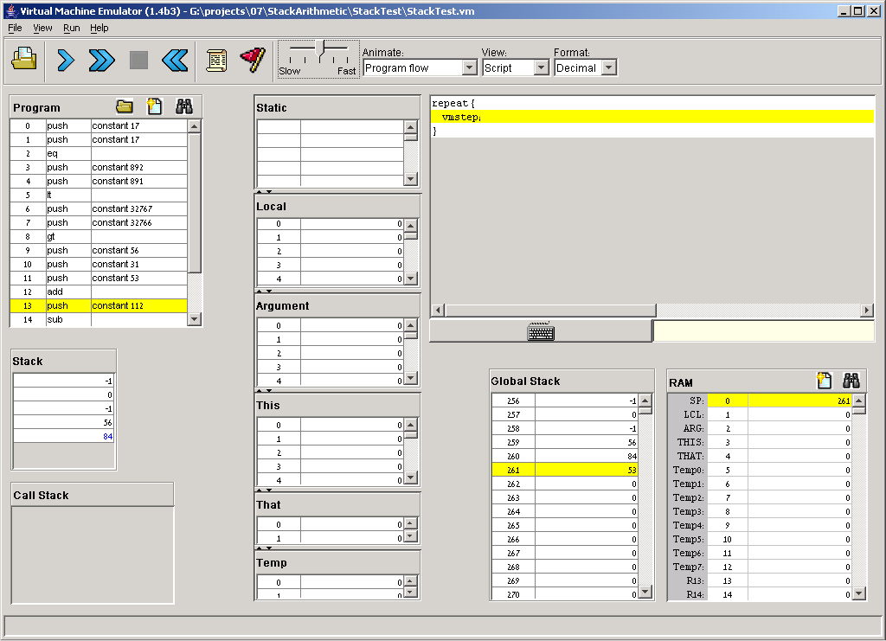
Running a Program
Impact of first 13 “vmsteps”

Slide 12
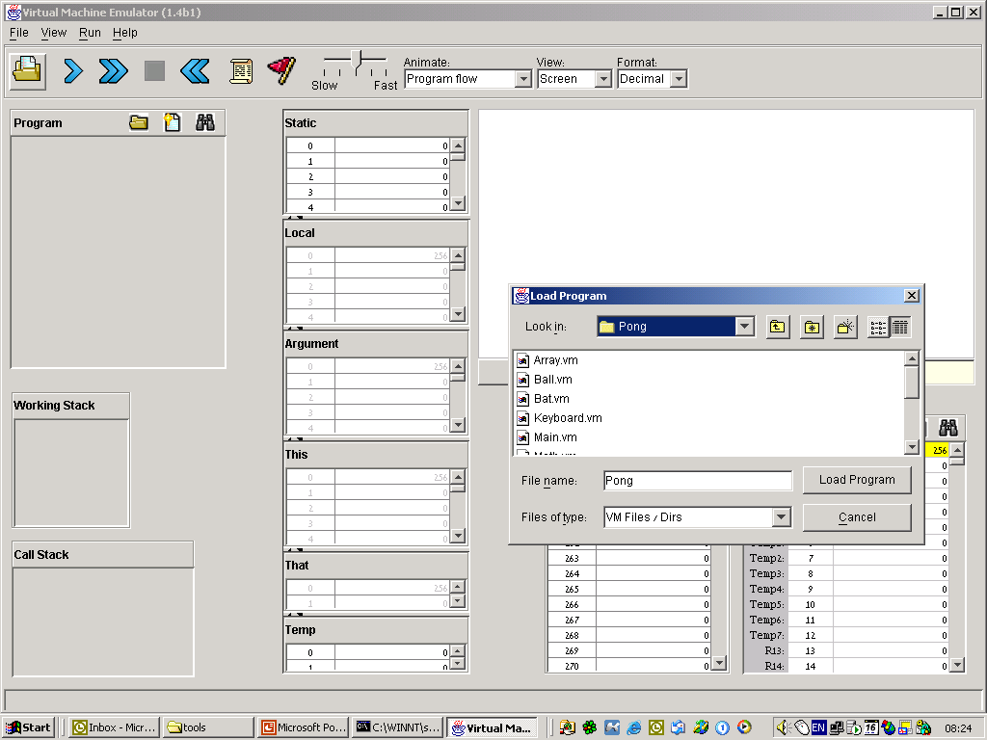
Loading a Multi-File Program
Most VM programs, like Pong, consist of more than one .vm file. For example, the Jack compiler generates one .vm file for each .jack class file, and then there are all the .vm fies comprising the operating system. All these files must reside in the same directory.
Therefore, when loading a multi-file VM program into the VM emulator, one must load the entire directory.
Won’t work!
Why? Because Pong is a multi-file program, and ALL these files must be loaded. Solution: navigate back to the directory level, and load it.

Slide 13
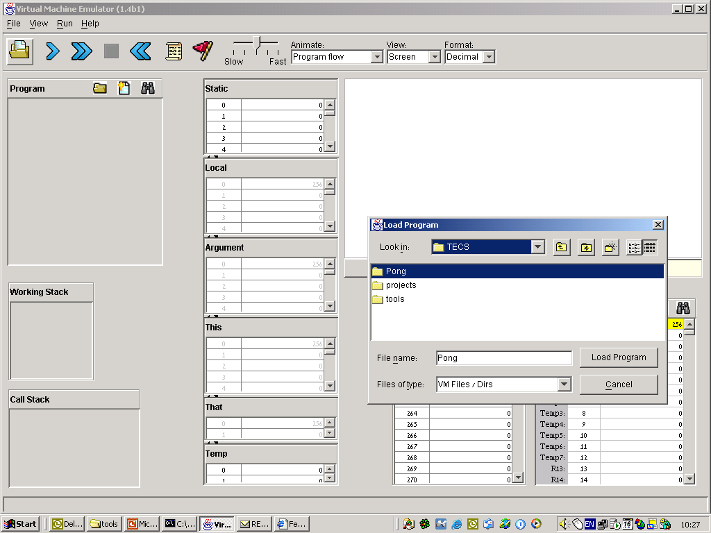
Loading a Multi-File Program

Slide 14
VM Emulator Tutorial
Part II:
Virtual Memory
Segments

Slide 15
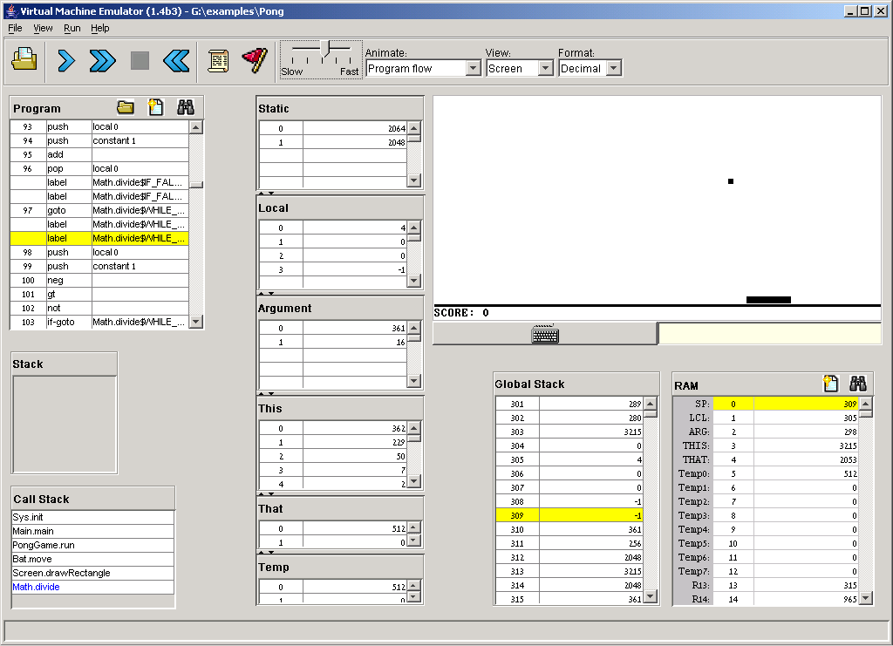
Virtual Memory Segments
A technical point to keep in mind:
Most VM programs include pop and
push commands that operate on
Static, Local, Argument, etc.;
In order for such programs to operate properly, VM implementations must initialize the memory segments’ bases, e.g. anchor them in selected addresses in the host RAM;
Case 1: the loaded code includes function calling commands. In this case, the VM implementation takes care of the required segment initializations in run-time, since this task is part of the VM function call-and-return protocol;
Case 2: the loaded code includes no function calling commands. In this case, the common practice is to load the code through a test script that handles the necessary initialization externally.
Memory segments:
The VM emulator displays the states of 6 of the 8 VM’s memory segments;
The Constant and Pointer segments are not displayed.

Slide 16
VM Emulator Tutorial
Part II:
Using Scripts

Slide 17
Typical VM Script
load BasicTest.vm,
output-file BasicTest.out,
compare-to BasicTest.cmp,
output-list RAM[256]%D1.6.1
RAM[300]%D1.6.1 RAM[401]%D1.6.1
RAM[402]%D1.6.1 RAM[3006]%D1.6.1
RAM[3012]%D1.6.1
RAM[3015]%D1.6.1 RAM[11]%D1.6.1;
set sp 256,
set local 300,
set argument 400,
set this 3000,
set that 3010;
repeat 25 {
vmstep,
output;
}
Typical “script setup” commands
Simulation step
(a series of script commands ending with a semicolon)
Typical memory segments initialization commands
Next
simulation
step
Repeated
simulation
step
Typical execution loop

Slide 18
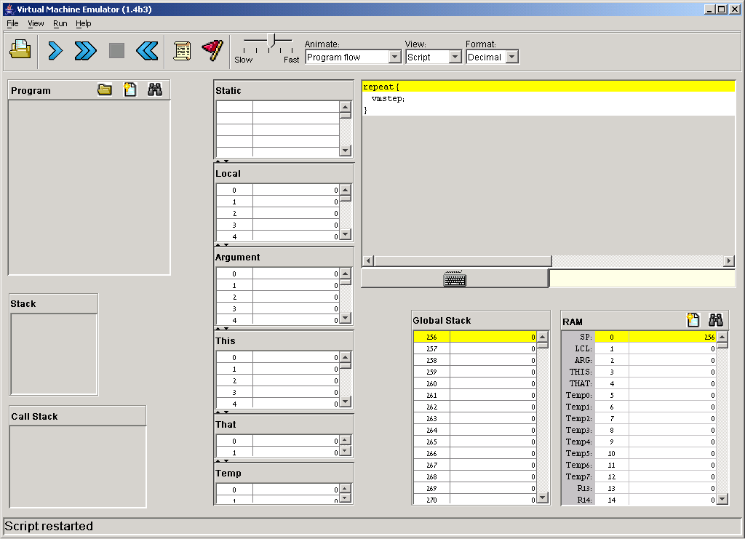
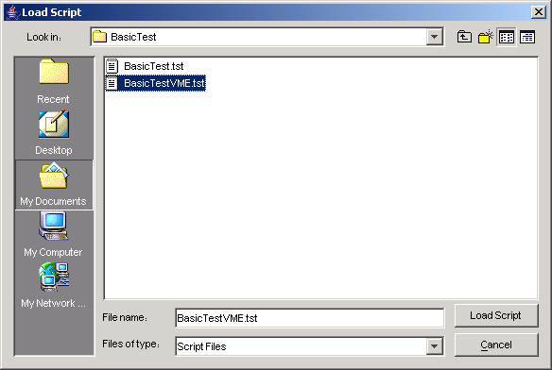
Loading a Script
Navigate to a directory and select a .tst file.

Slide 19
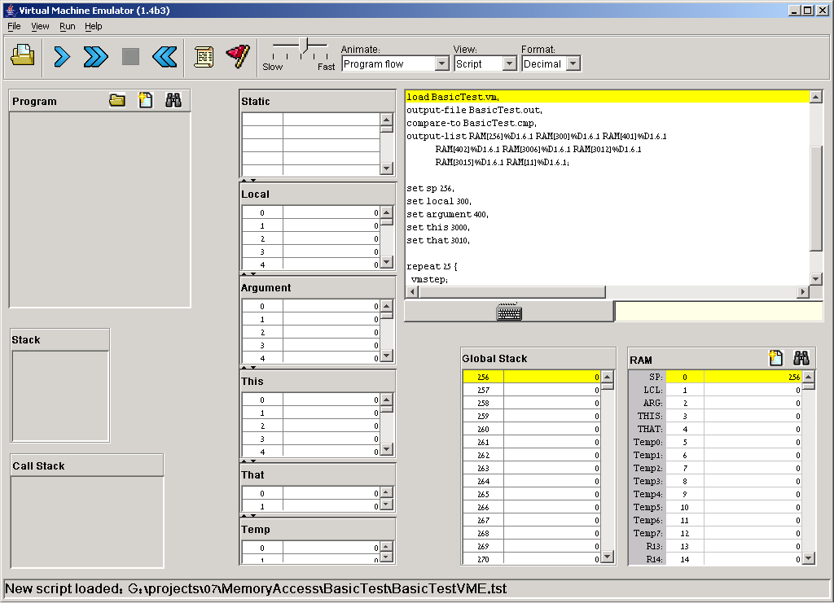
Script Controls
Execution speed
control
Script = a series of simulation steps, each ending with a semicolon;
Reset
the script
Pause the simulation
Execute step after step repeatedly
Execute the next simulation step

Slide 20
Running the Script
Loads a VM program into the emulator

Slide 21
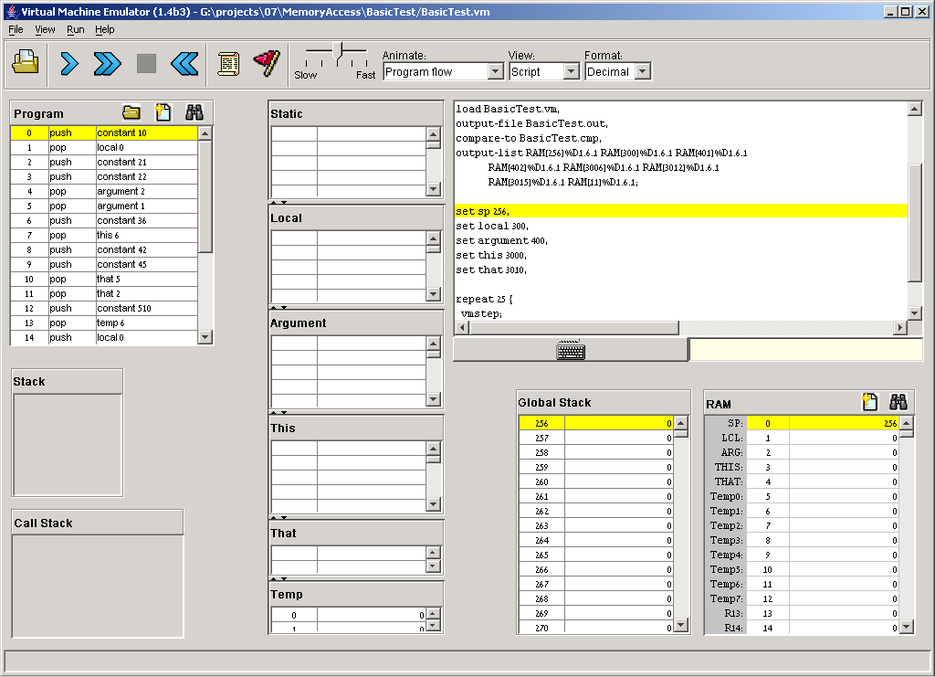
Running the Script
VM code is loaded

Slide 22
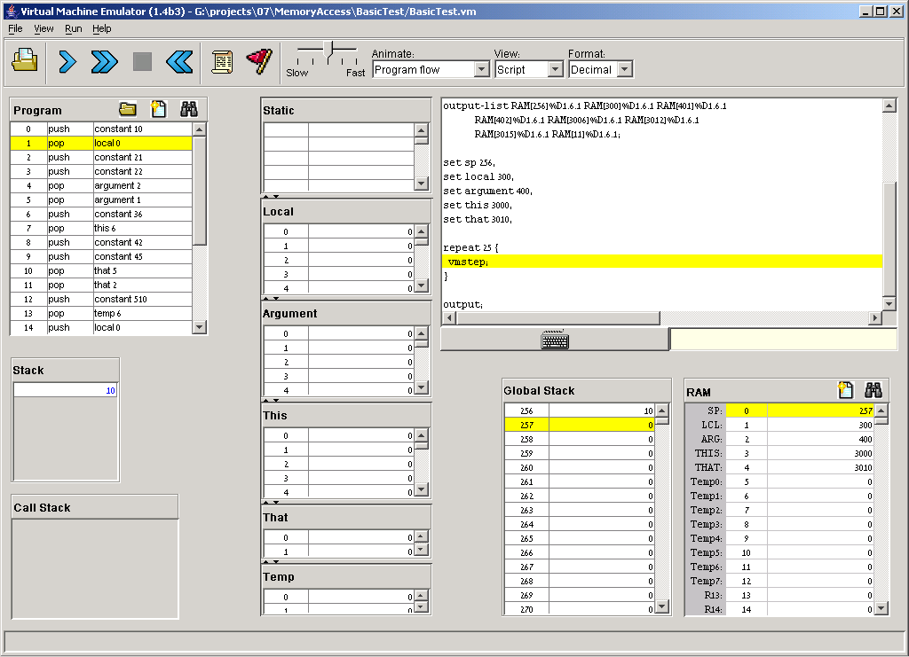
Running the Script
(click a few times)
The memory segments were initialized (their base addresses were anchored to the RAM locations specified by the script).
A loop that executes the loaded VM program

Slide 23
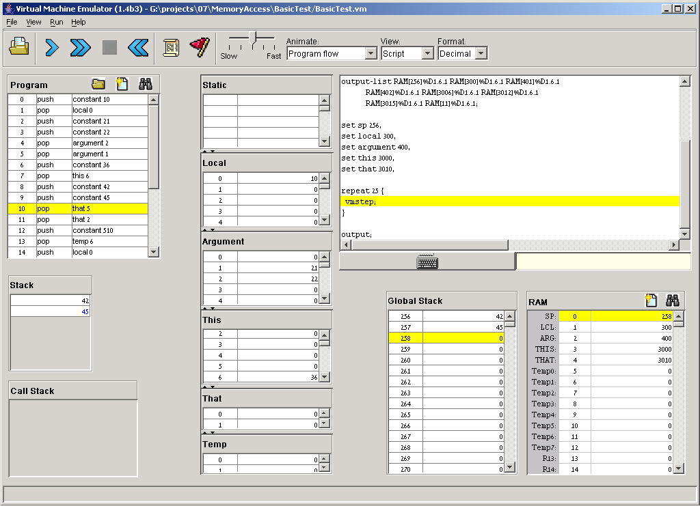
Running the Script
Impact after first 10 commands are executed

Slide 24
VM Emulator Tutorial
Part III:
Debugging

Slide 25
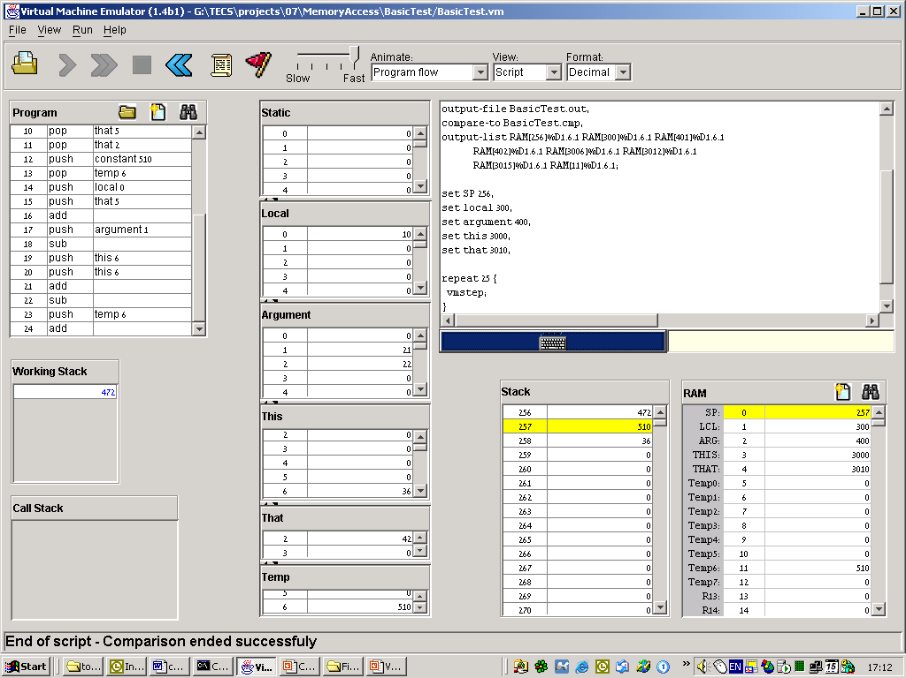
View Options
View options:
Script: displays the loaded script;
Output: displays the generated output file;
Compare: displays the given comparison file;
Screen: displays the simulated screen.
When the script terminates, the comparison of the script output and the compare file is reported.

Slide 26
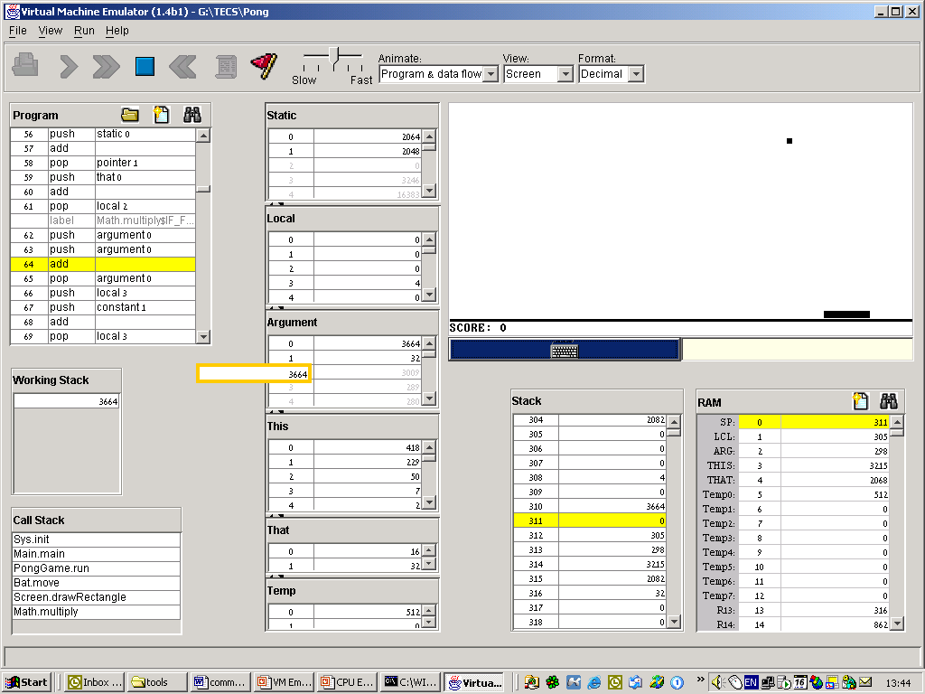
Animation Options
Speed control
(of both execution and animation)
Animation control:
Program flow (default): highlights the next VM command to be executed;
Program & data flow: highlights the next VM command and animates data flow;
No animation: disables all animation
Usage tip: To execute any non-trivial program quickly, select no animation.
source
transit
destn.
data flow animation related to the last VM command (in this example: push argument 0)

Slide 27
Breakpoints: a Powerful Debugging Tool
The VM emulator keeps track of the following variables:
segment[i]: Where segment is either local, argument, this, that, or temp
local, argument, this, that: Base addresses of these segments in the host RAM
RAM[i]: Value of this memory location in the host RAM
sp: Stack pointer
currentFunction: Full name (inc. fileName) of the currently executing VM function
line: Line number of the currently executing VM command
Breakpoints:
A breakpoint is a pair <variable, value> where variable is one of the labels listed above (e.g. local[5], argument, line, etc.) and value is a valid value
Breakpoints can be declared either interactively, or via script commands
For each declared breakpoint, when the variable reaches the value, the emulator pauses the program’s execution with a proper message.

Slide 28
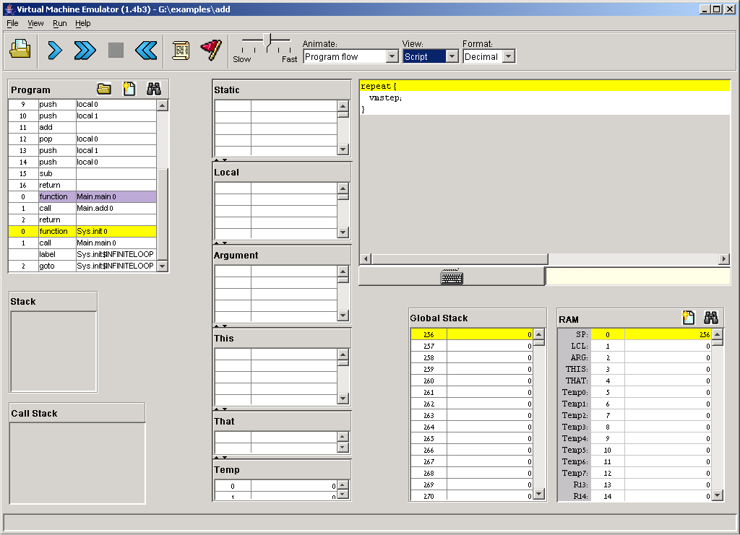
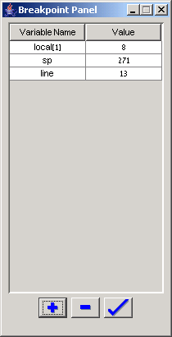
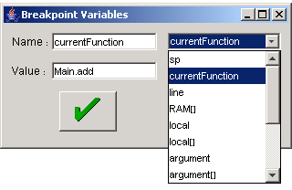
Setting Breakpoints
2. Previously-declared breakpoints
By convention, function headers are colored violet
4. Select the variable on whose value you wish to break
1. Open the breakpoint panel
Here the violet coloring is overridden by the yellow “next command” highlight.
5. Enter the value at which the break should occur
A simple VM program: Sys.init calls Main.main, that calls Main.add (header not seen because of the scroll), that does some simple stack arithmetic.
3. Add, delete, or update breakpoints

Slide 29
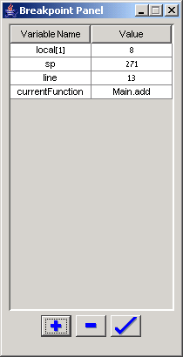
Setting Breakpoints
Breakpoints logic:
When local[1] will become 8, or when sp will reach 271, or when the command in line 13 will be reached, or when execution will reach the Main.add function, the emulator will pause the program’s execution.

Slide 30
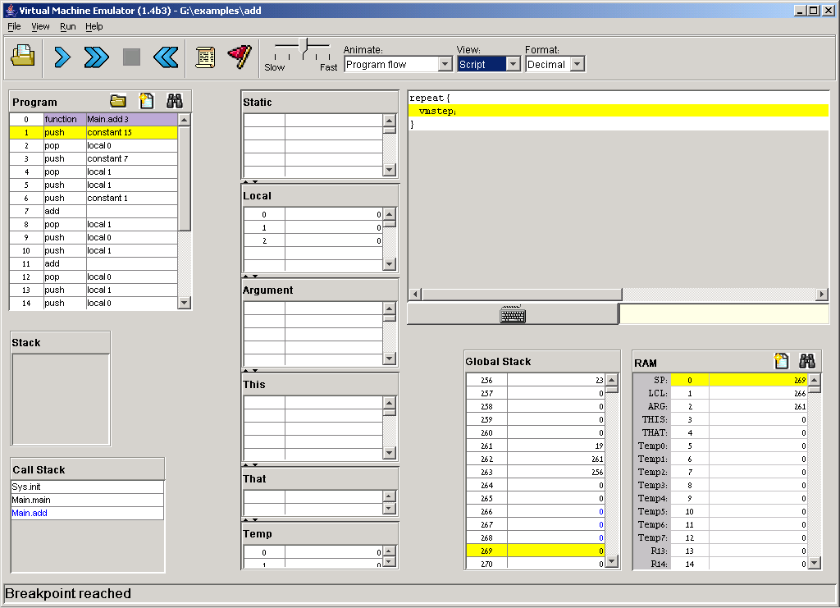
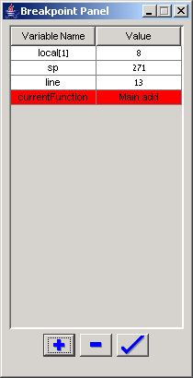
Breakpoints in Action
Execution reached the Main.add function, an event that triggers a display of the breakpoint and execution pause.

Slide 31
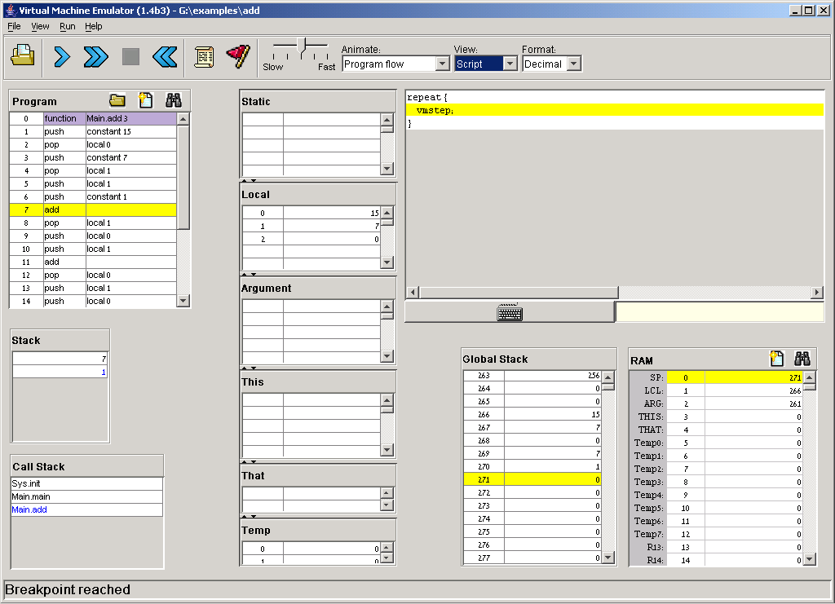
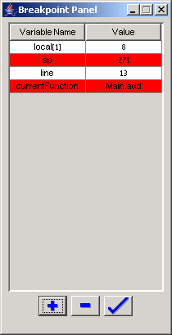
Breakpoints in Action
Following some push and pop commands, the stack pointer (sp) became 271, an event that triggers a display of the breakpoint and execution pause.

Slide 32
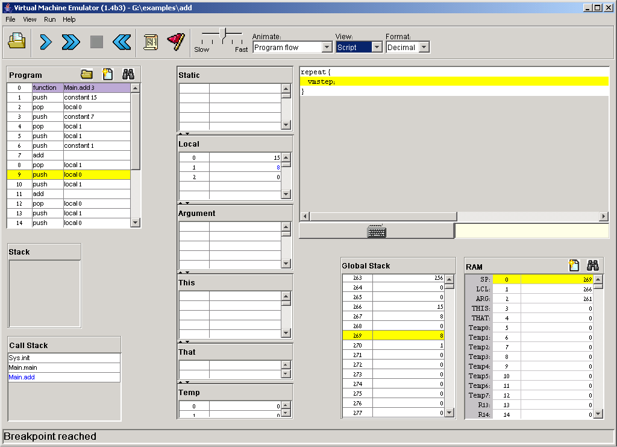
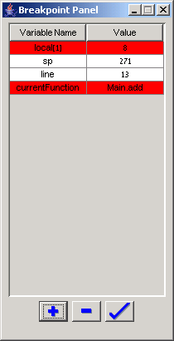
Breakpoints in Action
A powerful debugging tool!
Following some more execution, the second local variable (local[1]) became 8, an event that triggers a display of the breakpoint and execution pause.

Slide 33
Breakpoints in Scripts
load myProg.vm,
output-file myProg.out,
output-list sp%D2.4.2
CurrentFunction%S1.15.1
Argument[0]%D3.6.3
RAM[256]%D2.6.2;
breakpoint currentFunction Sys.init,
set RAM[256] 15,
set sp 257;
repeat 3 {
vmStep,
}
output;
while sp < 260 {
vmstep;
}
output;
clear-breakpoints;
// Etc.
For systematic and replicable debugging, use scripts
The first script commands usually load the .vm program and set up for the simulation
The rest of the script may use various debugging-oriented commands:
  Write variable values (output)
  Repeated execution (while)
  Set/clear Breakpoints
  Etc. (see Appendix B.)

Slide 34
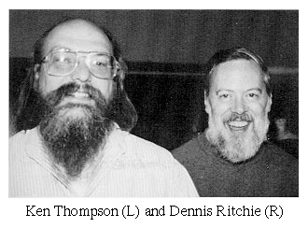
End-note on Creating Virtual Worlds
“It’s like building something where you don’t have to order the cement. You can create a world of your own, your own environment, and never leave this room.”
(Ken Thompson,
1983 Turing Award lecture)

